Slide 1
UK Productivity Analysis
Project by KangHin Lee
D-12 Data Analyst Course
16th March 2022

Slide 2
1. Introduction

Slide 3


What is productivity
$$Productivity= \frac{Labour Output}{Labour Input}$$
$$Growth rate=rate of change in productivity per year$$
Notes:
Productivity is a economic concept for measuring labour efficiency, given by the output volume per labour input. A high productivity can leads to an increasing profitability of the company/country.
Meaning we can either produce higher output with the same amount of work, or produce the same output with less labour required.
Productivity can be measured different ways, and for this analysis we will only be using output per hour worked as our definitions of productivity.
The Growth rate is the rate of change in productivity, this productivity minus last year’s productivity

Slide 4
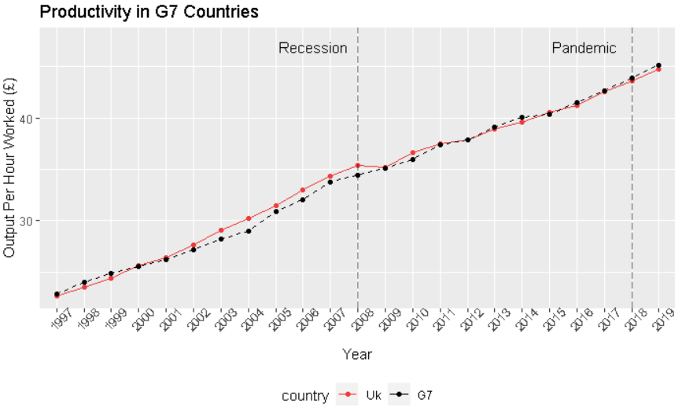
Productivity between UK & G7 Countries
Notes:
Since 2000 the UK’s productivity is always higher than the G7 countries until the great recession in 2008. Since then, the UK’s productivity has been underperformed to a point where our productivity is lower than the G7 average.

Slide 5
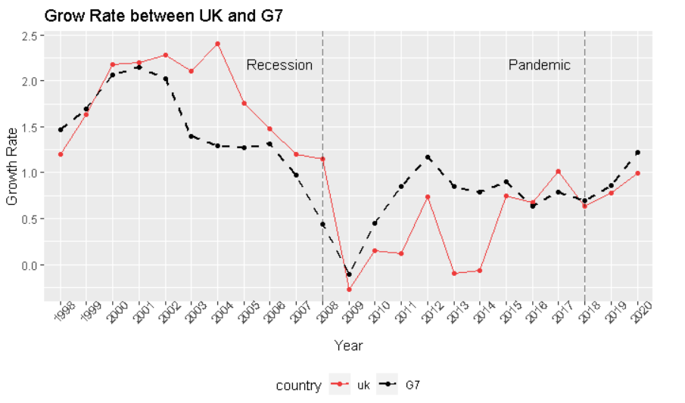
Grow Rate between UK and G7 Countries
Notes:
The underperforming characteristics can be seen in the growth rate graph. After 2008, we can see the G7’s growth rate has rose rapidly , whereas the UK’s grow rate remained leads to an decrease in productivity.
This is the initiative for this project that we need to find ways to improve UK’s competitiveness to the market.

Slide 6
Aim of the Project
Business Question:
How can we improve productivity within Scotland and the UK overall?
MVP:
Which industries are lagging behind in terms of productivity?
What factors can be improved to increase employee and/or business productivity across UK regions?

Slide 7
2. Productivity Growth Per Industry

Slide 8
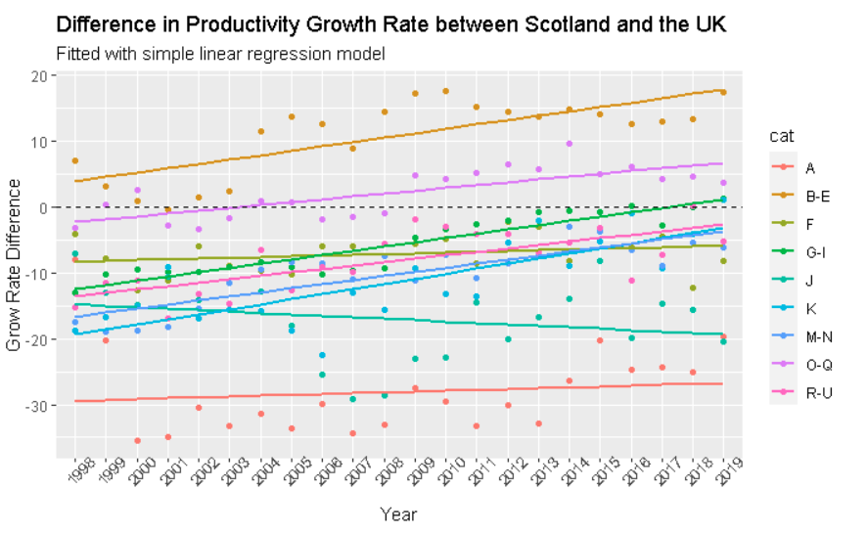
Productivity Growth Per Industry
SIC | Category Name
A | Primary Product
B-E | Engineering
F | Civil Construction
G-I | Tertiary product
J | Information and communication
K | Finance
M-N | Academic
Notes:
In this analysis we will be comparing how different industries perform. The industries is grouped by UK’s standard industrial classification.
The indicator that I have used is the difference in growth rate to measure the performance per industry. It indicates how fast Scottish industries are growing when compared to the UK in terms of productivities. If the data point is above 0 it means Scotland is performing better than the UK and vice versa.
I then constructed a validated linear regression model to see the over trend of the growth for the industries.

Slide 9
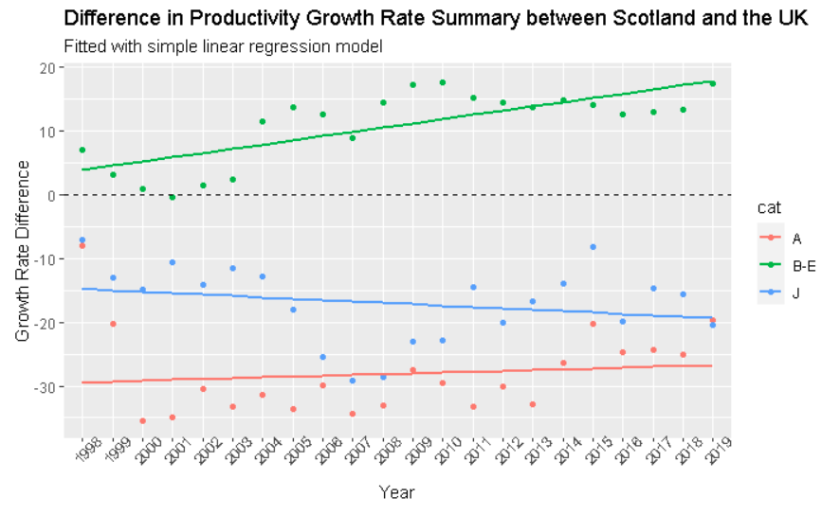
Productivity Growth Per Industry Summary
SIC | Category Name
A | Primary Product
B-E | Engineering
J | Information and communication
Notes:
I have summarise the highlight from the graph.
The best performed Scottish industry is engineering, with the data points laying above the margin with a positive gradient. Meaning the industry is always perform better than the rest of the UK and will be better throughout the years.
Primary Product Industry in red, has the highest negative margin, meaning the productivity growth is always slower than the rest of the UK, however, the positive gradient indicates the industry is slowing catching up.
Out of all industries, only group J, Information and communication group, has a negative margin whilst having a negative gradient, indicating the industry is declining throughout the year.
A similar analysis was carried out comparing UK and G7 countries. However, stat showed that the analysis was insignificant with an irrelevant relationship between the regression and the data point itself. Therefore I won’t be presenting the result in this presentation.

Slide 10
3. Productivity Factors

Slide 11
Productivity Factors
Hypothesis Test:
2 Samples Independent Tests
5% Confidence Level
Dataset contains OECD countries
UK Standard as a reference
Economic Factors:
Average / Minimum Salary
Annual Hours Worked
Unemployment Rate
Inflation Rate
Education Proportion:-
Below Upper Secondary
Upper Secondary
Tertiary
Notes:
Conduct a series of hypothesis tests with the economic factors to find which one has a stat-significant influence to the labour productivity.
We have adapted 2 samples independent test, 5% confidence level.
We will be using Organisation for Economic Cooperation and Development countries (OECD) countries for the tests and UK as a reference index.
(i.e. Does a country with a higher salary than the UK, have a significant difference in productivity.)
Economic factors included: salary, total annual hours worked, unemployment and inflation rate, education proportion per population between 25 – 64 years old.

Slide 12
Hypothesis Test Results
Hypothesis Test Factors | Results | Impact on Productivity
Higher Min/Average Salary | Significant | Positive
Higher Worked Hours | Significant | Negative
Higher Unemployment Rate | Significant | Negative
Higher Inflation Rate | Significant | Negative
Upper Secondary Education | Significant | Positive
Below Upper Secondary Education | Insignificant | --
Tertiary Education | Insignificant | --
Notes:
Decouple Analysis and Confounding factors
The concluded drawn from the decoupled analysis for this project are for guidance only.
Interaction & cofounding factors are not taking into account but may affect to the labour’s productivity.
Higher min/avg wage, higher secondary education will have a high stat significant influence on the productivity.
Higher worked hours, unemployment rate and inflation rate will have a lower stat-significant influence on the productivity.

Slide 13
Conclusion
How can we improve productivity within Scotland and the UK overall?
1. Which industries are lagging behind in terms of productivity?
Scotland’s Information and Communication Industry
2. What factors can be improved to increase employee and/or business productivity across UK regions?
Increase: Minimum / average salary and Upper Secondary Education
Notes:
The productivity
Since 2008, when the great recession occurred, the productivity growth in the UK has been slowed down and led to a lower productivity when compared with G7 average.
In the industry productivity analysis. We have found that Scottish’s engineering industry performed the best among the others, with a strong growth rate.
Conversely, the Scottish Information and Communication Industry showed evidence of declining in growth rate.
A series of hypothesis tests are conducted with different economics factors. Factories that can improve productivity in the UK are:
Higher min/avg wage, higher secondary education will have a high stat significant influence on the productivity.
Higher worked hours, unemployment rate and inflation rate will have a lower stat-significant influence on the productivity.

Slide 14
The End

Slide 16
Industry Catagory
SIC Code | Category Name | Industries
A | Primary Product | Agriculture, forestry and fishing
B-E | Engineering | Industry (except construction)
F | Civil Construction | Construction / Civil Industry
G-I | Tertiary product | Wholesale and retail trade, transport, accommodation and food service activities
J | Information and communication | Information and communication
K | Finance | Financial and insurance activities
M-N | Academic | Professional, scientific and technical activities; administrative and support service activities

